Slide 1
Module 2: Transmission Characteristics of Optical Fiber Problems on Attenuation and Dispersion
EXTC – BE – Optical Communication (ECC703)
Prof. Shyamala Mathi
Assistant Professor
Dept. of Electronics and Telecommunication,
SIES Graduate School of Technology

Slide 2
Attenuation

Slide 3
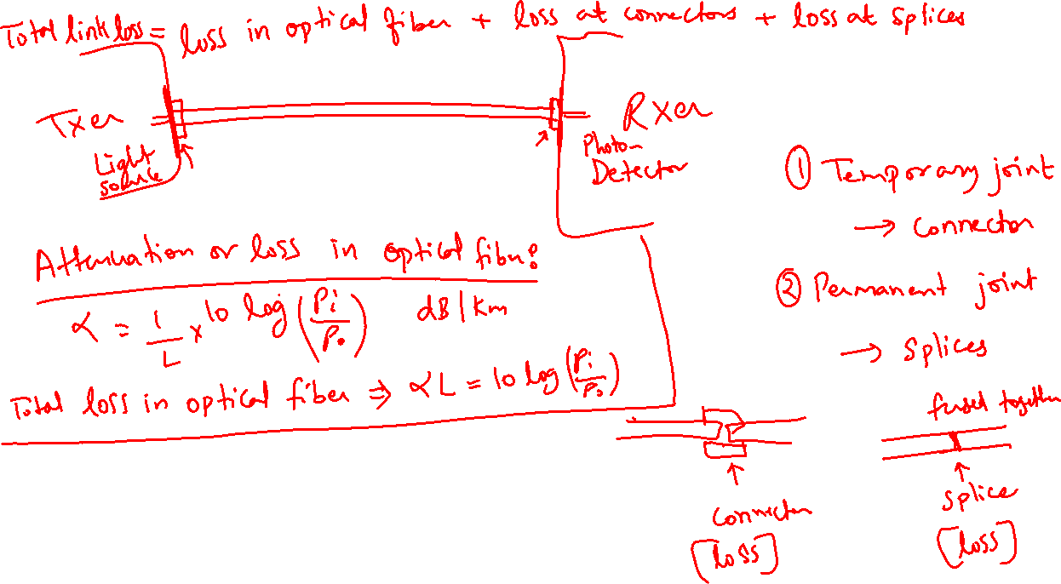

Slide 4
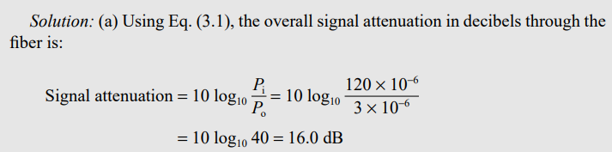
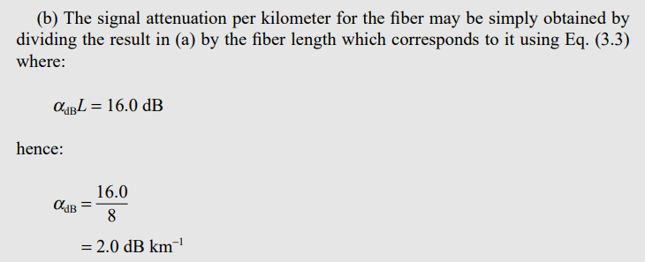

Slide 5
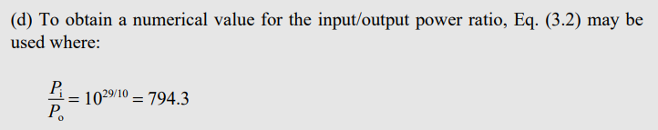
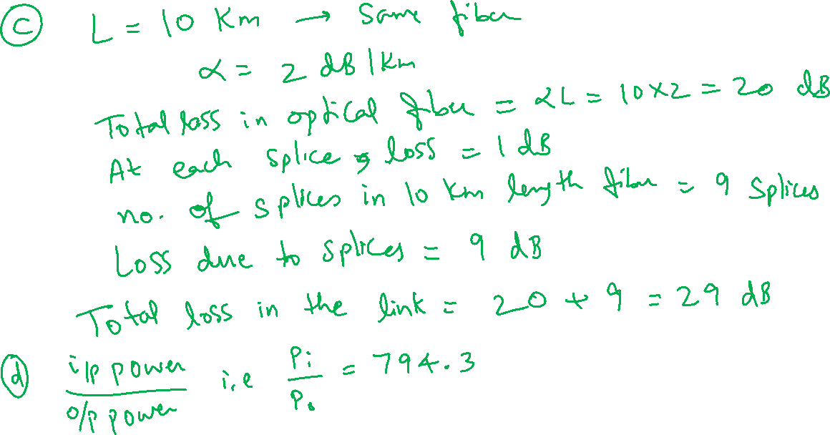

Slide 6
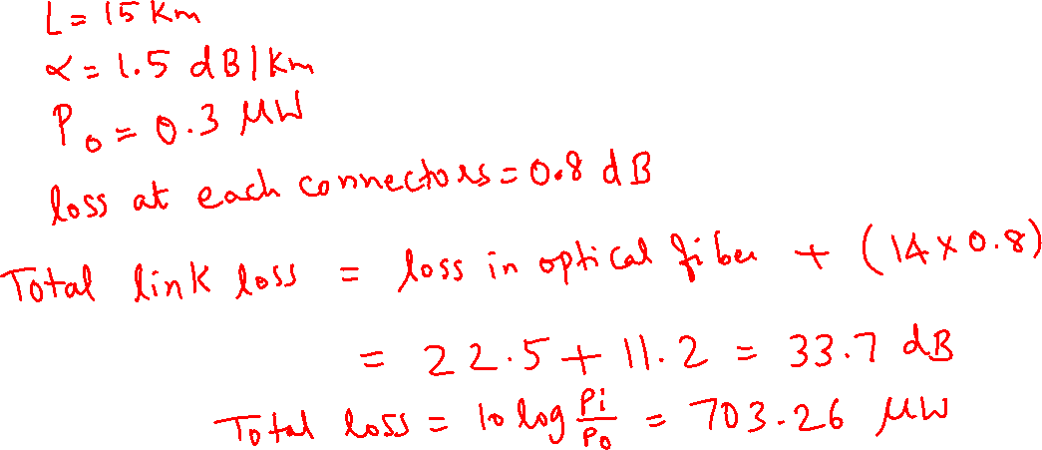
A 15 km optical fiber link uses fiber with a loss of 1.5 dB/km. The fiber is jointed at every kilometer with connectors which gave attenuation of 0.8 dB each. Determine the minimum mean optical power which must be launched into fiber in order to maintain a mean optical power level of 0.3 μw at the detector.

Slide 7
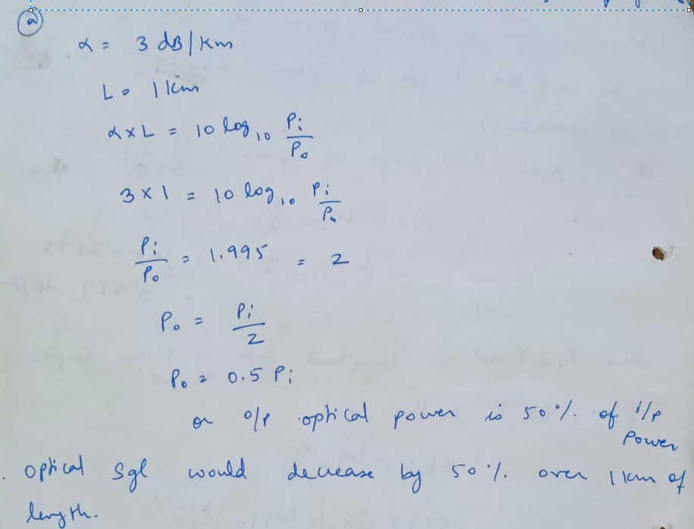
An optical fiber has a loss of 3 dB/km. By how much fraction the optical signal power would decrease over (a) 1 km (b) 2 km length of fiber.

Slide 8
The mean optical power launched into an optical fiber link is 1.5 mW and the fiber has an attenuation of 0.5 dB/km. Determine the maximum possible link length without repeaters (assuming lossless connectors) when the minimum mean optical power level required at the detector is 2 microwatts.

Slide 9
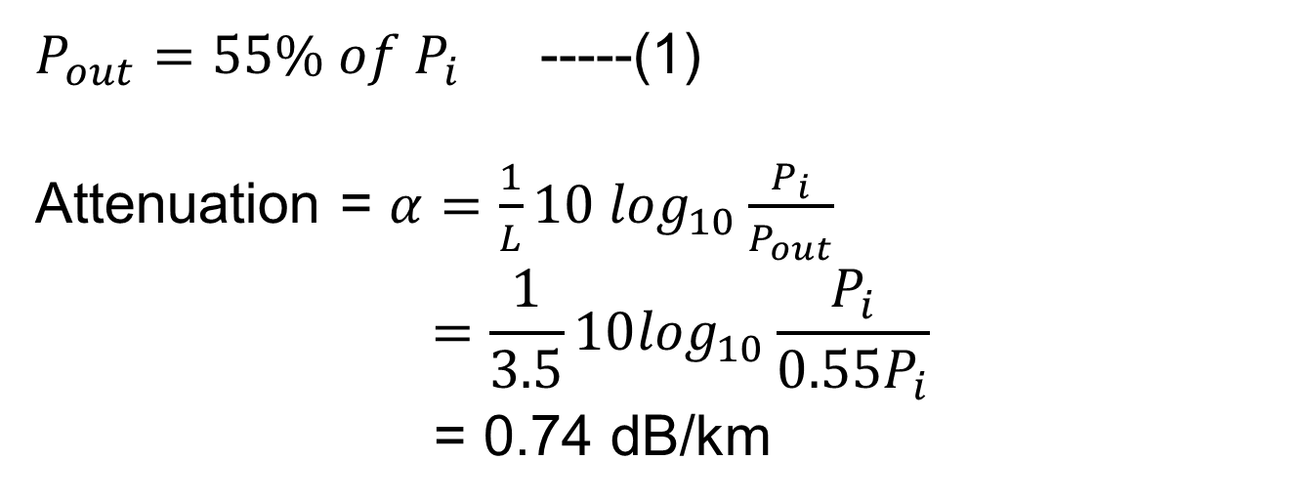
An optical fiber has 55% of power after traversing 3.5 km of fiber. What is the loss in dB/km of this fiber?
$P_{out}=55\% of P_{i}$ -----(1)
Attenuation = $α=\frac{1}{L}10 \log_{10}\frac{P_{i}}{P_{out}}$
$$=\frac{1}{3.5}10\log_{10}\frac{P_{i}}{{0.55P}_{i}}$$
= 0.74 dB/km

Slide 10
The numerical input/output mean optical power ratio in a 1 km length of optical fiber is found to be 2.5. Calculate the received mean optical when a mean optical power of 1 mW is launched into a 5 km length of fiber (assuming no-joints or connectors)

Slide 12
Thank You!
(shyamalae@sies.edu.in)

